Slide 1
Using the Atriuum to Find a Book

Slide 2
Destiny is a type of OPAC
So…what is an OPAC????
Online Public Access Catalog or more simple put, a Library Catalog
Still confused??
It is simply a way of searching for a book

Slide 3
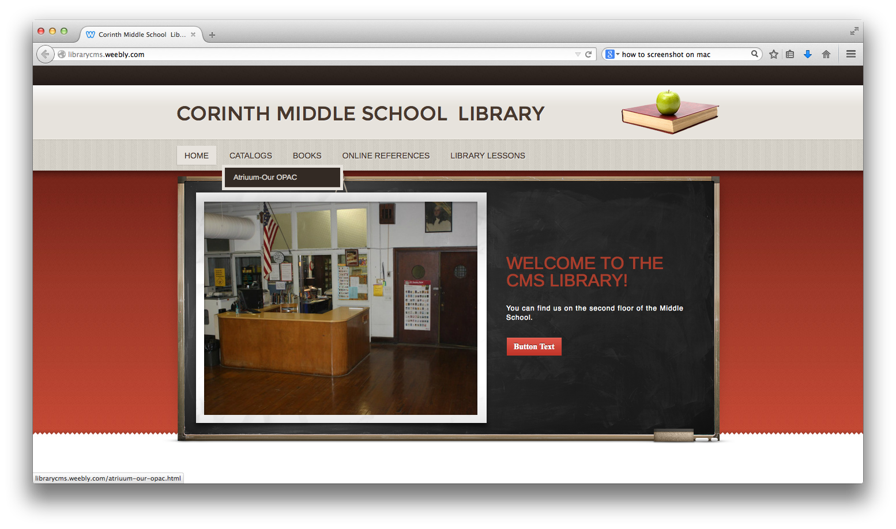
Click on Atriuum Our OPAC

Slide 4
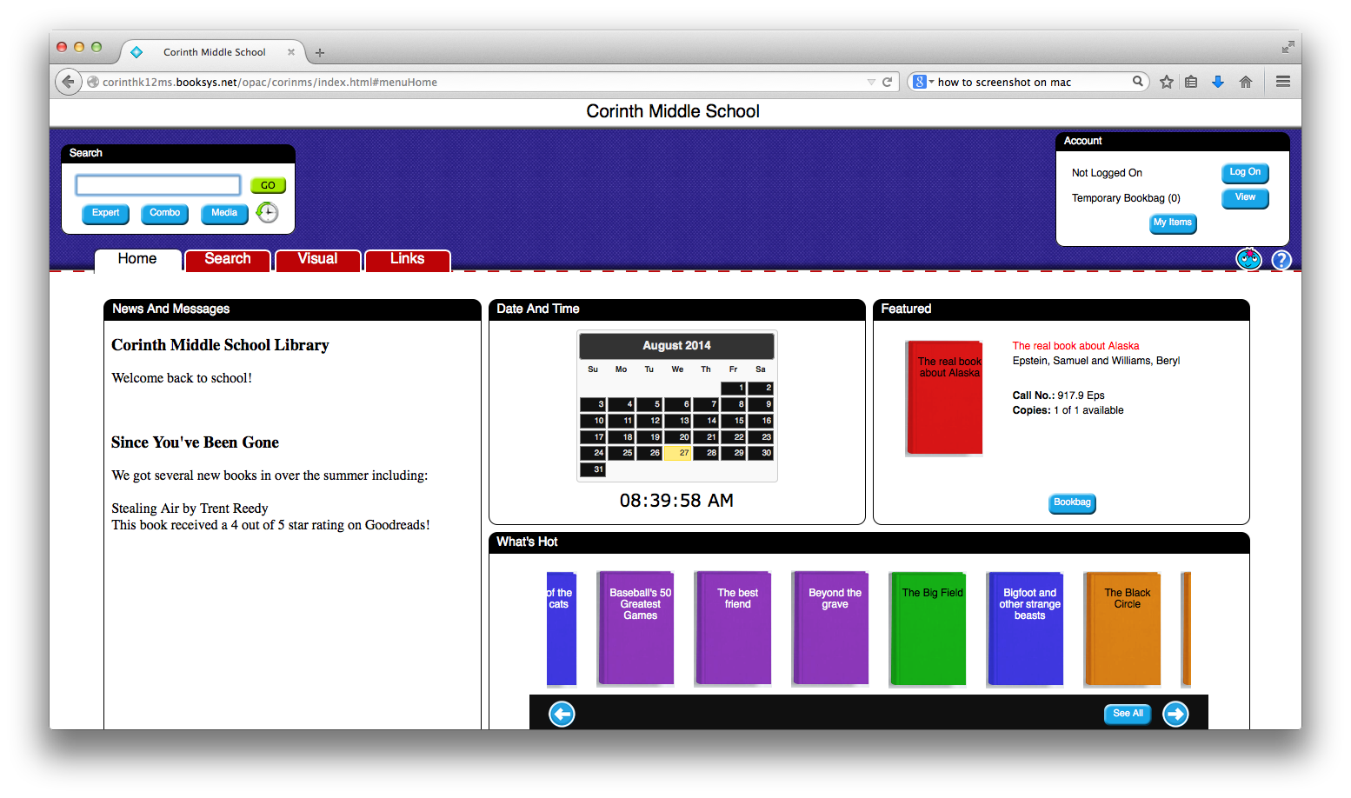
This is where you type in what you are looking for!
This is what the home page looks like!!

Slide 5
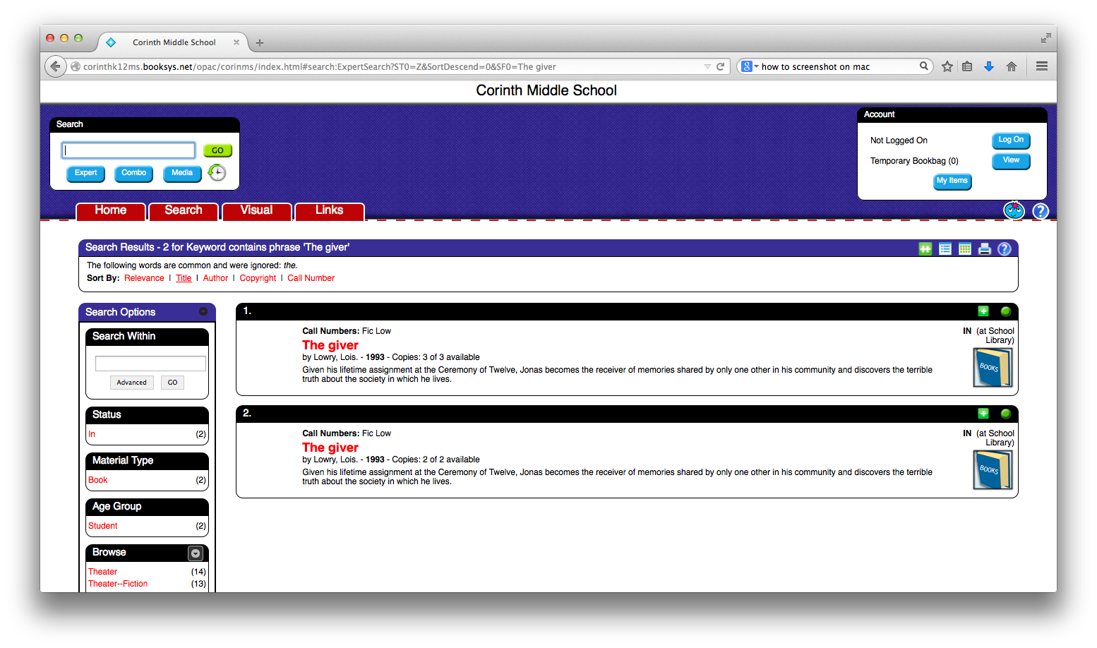
I typed in “The Giver” (title search)

Slide 6
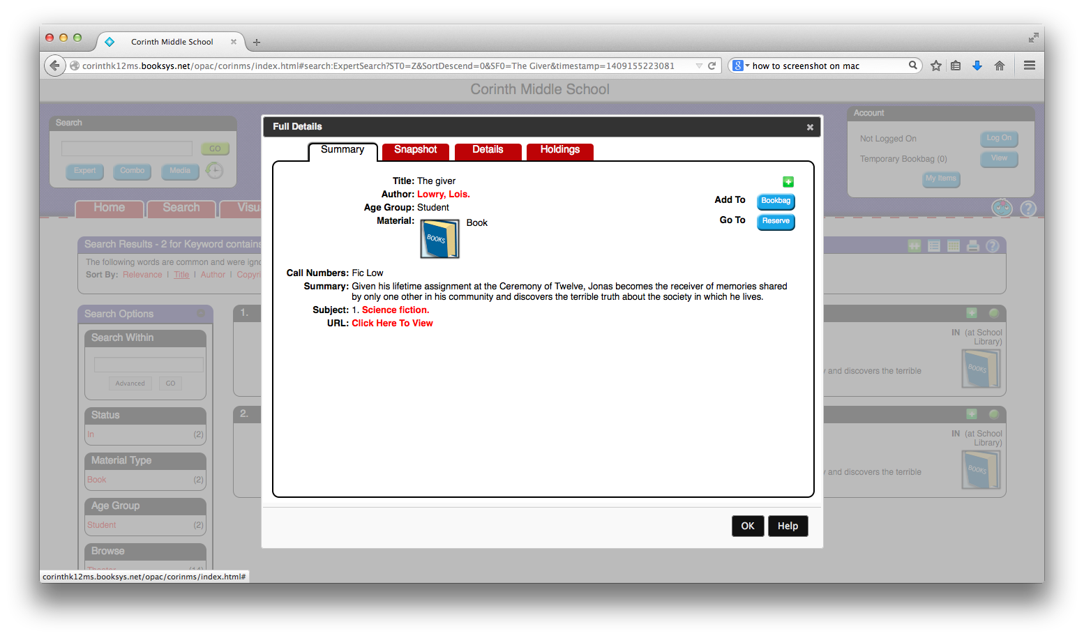
Call number!!!
FIC Low
What info do I need to find the book on the shelf???

Slide 7
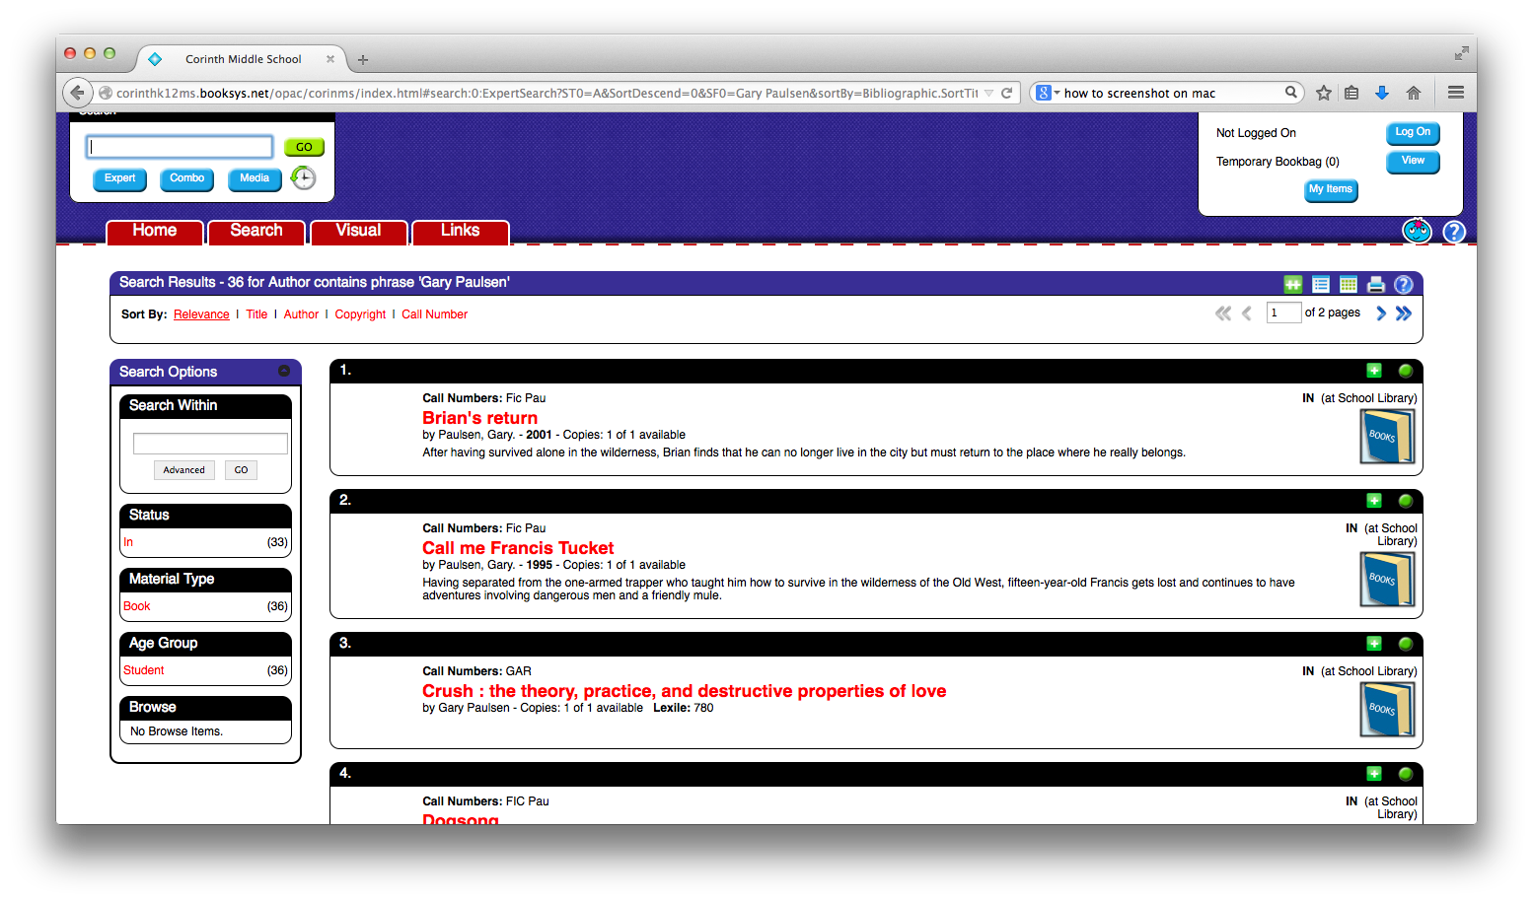
I typed in “Gary Paulsen” (Author search)
2 Pages of Titles

Slide 8
To search by subject—click on COMBO

Slide 9
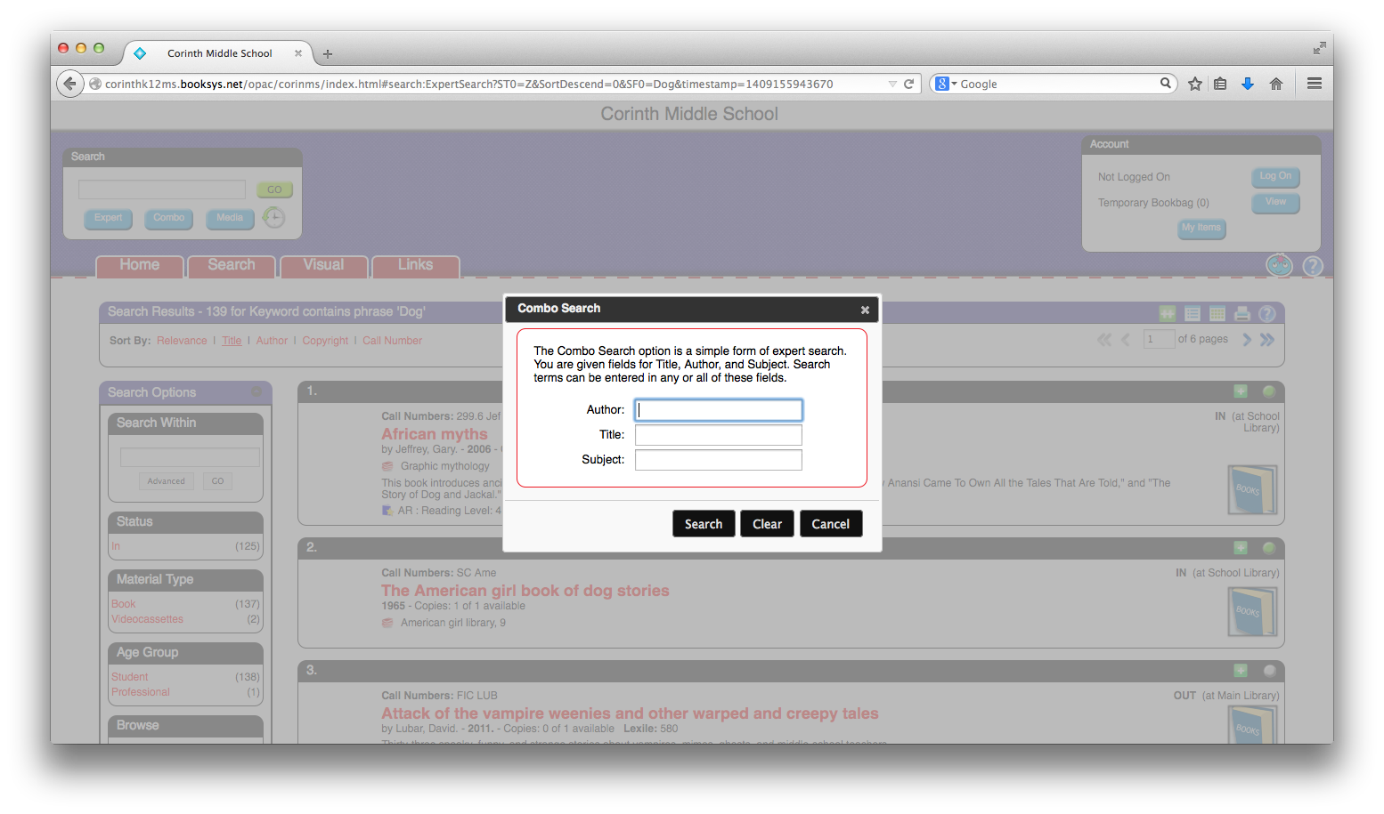
Type in the subject you want to search

Slide 10
Other helpful features of Destiny…

Slide 11
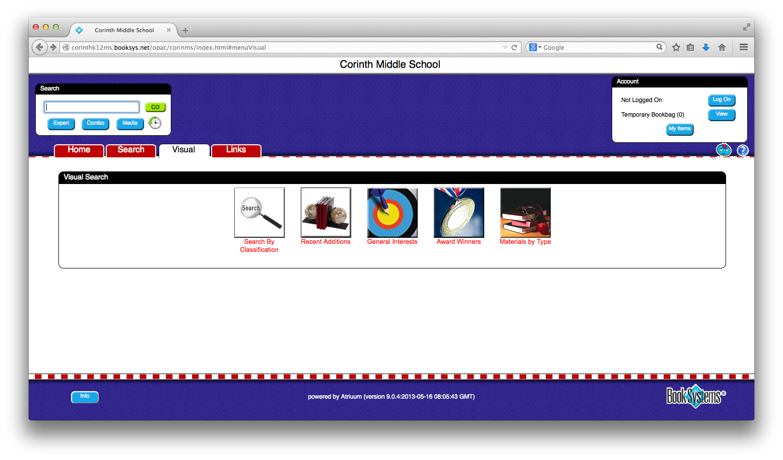
New Arrivals

Slide 12
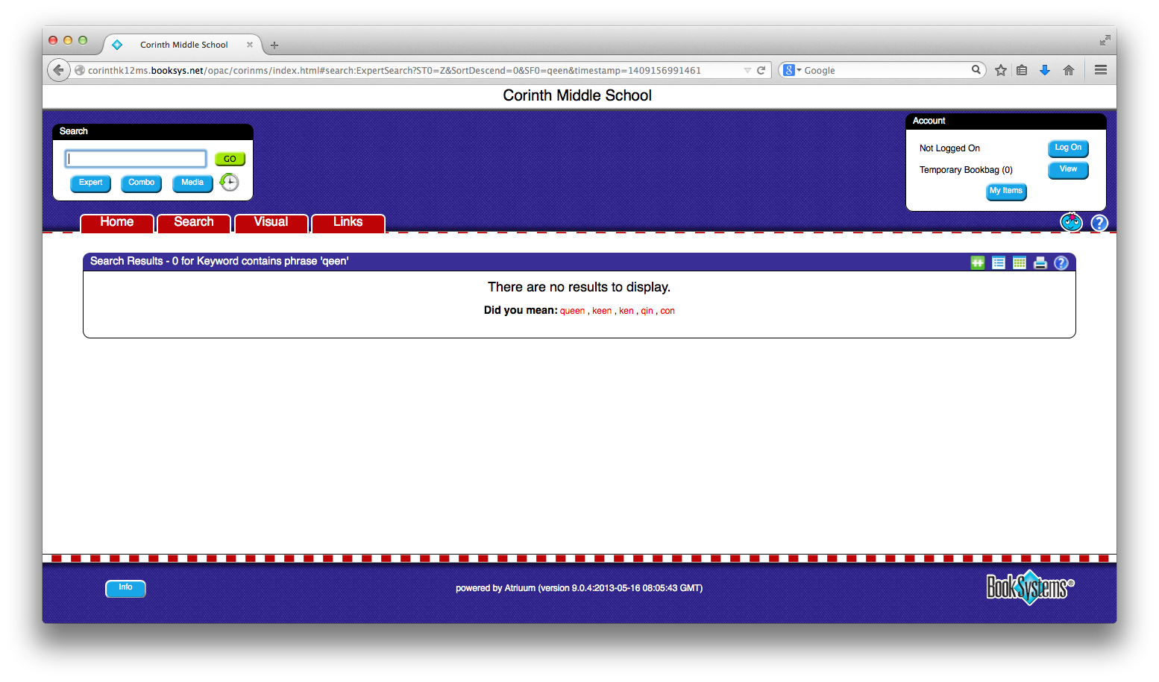
This is what happens if you misspell a word…

